Slide 1
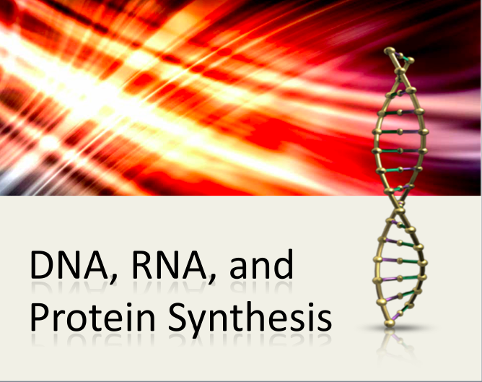
© Amy Brown – Science Stuff

Slide 2
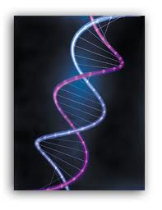
The Chemistry of Heredity
By the 1940's, there was no doubt of the existence of chromosomes and that genes were on the chromosomes. But there were so many questions that needed to be answered:
What were genes and what did they do?
How do genes work?
How do genes determine the characteristics of an organism?
Amy Brown Science Stuff Copyrighted

Slide 3
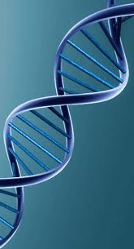
Genes must be capable of three
critical things:
1. Genes must carry information from one generation to the next.
2. Genes must be able to put the information that they carry to work to produce the traits of the organism.
3. There must be a mechanism of easily copying the gene because the information must be replicated every time a cell divides.

Slide 4
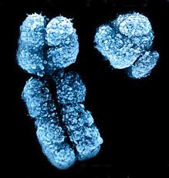
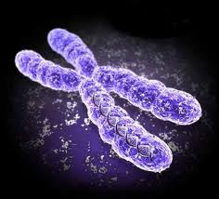
Chemical analysis shows that a chromosome is composed of:
half nucleic acid and half protein.
It was originally thought that the protein portion of the chromosome carried the genetic information. Very little was known in the early days about the nucleic acids.
This hypothesis was wrong.

Slide 5
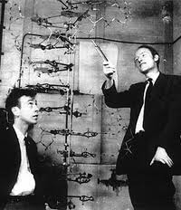
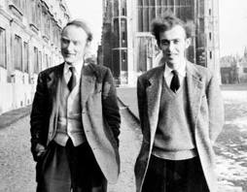
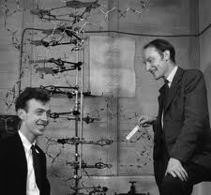
In 1953, James Watson and Francis Crick shook the scientific world with their model for the structure of DNA.
It then became obvious that Mendel's heritable factors and the genes on chromosomes are composed of DNA.

Slide 6
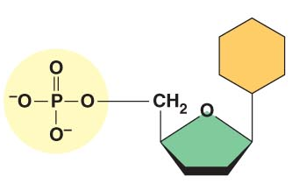
DNA – Deoxyribonucleic acid
nucleotides
DNA molecules consist of small units called ____________. Several million nucleotides make up one strand of DNA.
Nucleotides consist of:
a) a phosphate group
b) a 5-carbon sugar called deoxyribose
c) a nitrogen base
nitrogen
base
phosphate
group
deoxyribose
Phosphate + sugar + nitrogen base = 1 nucleotide

Slide 7
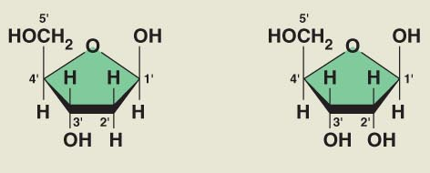
The sugar is a 5-carbon sugar called __________.
deoxyribose

Slide 8
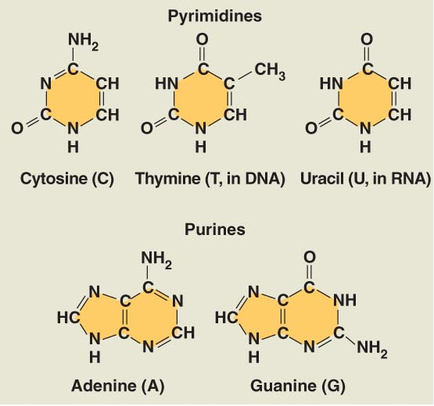
The four nitrogen bases found in DNA are:
Adenine – A
Guanine – G
Thymine – T
Cytosine – C
NOTE: The nitrogen base uracil is only found in RNA.
We will discuss uracil later.
Purines:
Double ring structures;
adenine and guanine are purines.
Pyrimidines:
single ring structures;
cytosine and thymine are pyrimidines.

Slide 9
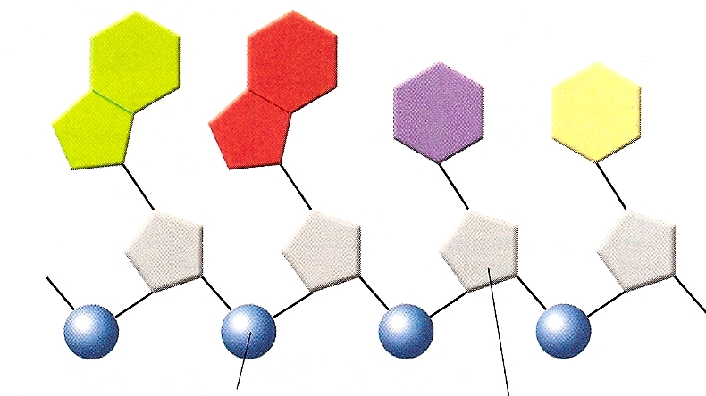
Nucleotides are joined together in this way:
The backbone of a DNA chain is formed by alternating:
sugar and phosphate groups.
nucleotide
phosphate
sugar
nitrogen base
phosphate
nitrogen base
sugar
phosphate
nitrogen base
sugar
The nitrogen bases stick out sideways from the chain.
In the late 1940’s and early 1950’s, it was not understood how this molecule could carry the genetic information and put this genetic information to work in a cell.

Slide 10
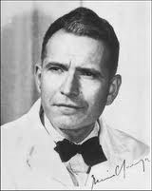
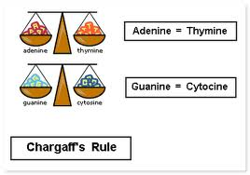
Erwin Chargaff
In 1947, an American scientist named Erwin Chargaff discovered that:
the amount of guanine and cytosine bases are equal in any sample of DNA.
The same is true for the other two nitrogen bases:
The amount of adenine and thymine are equal in any sample of DNA.
The observation that ______and that ______ became known as _____________.
A = T
C = G
Chargaff’s rules
At the time this observation was made, it was not clear why this fact was so important.

Slide 11
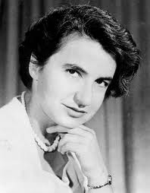
The X-Ray Evidence by Rosalind Franklin
In the early 1950’s, a British scientist, Rosalind Franklin began to study DNA.
She used a process called _____________.
X-ray diffraction
She took a large, purified sample of DNA, aimed a powerful x-ray beam at the sample, then recorded the scattering pattern of x-rays on film.

Slide 12

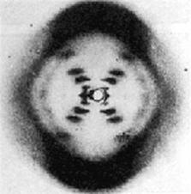
Franklin’s X-Ray Diffraction
By itself, these x-rays did not reveal the structure of the DNA molecule, but it did provide clues about the structure.
The x-rays showed that the strands in DNA were:
twisted around each other in a shape known as a helix.
The x-rays suggested that there were:
two strands in the structure.
It appeared that the nitrogen bases were:
at the center of the molecule.

Slide 13
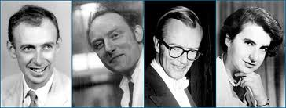
At the same time that Franklin was doing her research, two scientists named Francis Crick and James Watson, were trying to understand the structure of DNA by building models of it. They were getting nowhere.
The Players
James
Watson
Francis
Crick
Maurice
Wilkins
Rosalind Franklin
Early in 1953, Watson was shown a copy of Franklin’s x-ray patterns, and he immediately realized how the DNA molecule was arranged. Within weeks, Watson and Crick built a model that showed:
1) The structure of DNA
2) It explained how DNA could carry information and how it could be copied.

Slide 14
Watson and Crick described the DNA molecule as a __________ or spiral consisting of __________ wound around each other.
double helix
two strands
Timeline
1953 – Watson and Crick solve the structure of DNA
1958 – Rosalind Franklin dies of ovarian cancer at age 37
1962 – Watson, Crick and Wilkins win the Nobel Prize

Slide 15
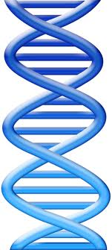
The Watson and Crick Model of DNA
A double helix looks like a ____________.
twisted ladder
Alternating sugar and phosphate groups
The sides of the ladder are formed from alternating:
sugar and phosphate groups.
Two nitrogen bases connected across the center of the helix by weak hydrogen bonds.
The rungs of the ladder are formed by:
two nitrogen bases that pair together across the center of the helix.
The two strands are joined by weak _________ bonds.
hydrogen

Slide 16
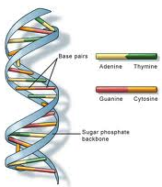
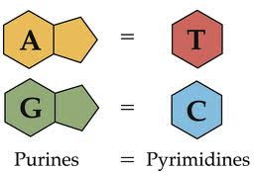
The Watson and Crick Model of DNA
These hydrogen bonds form only between certain base pairs:
adenine is always bonded to thymine and guanine is always bonded to cytosine.
This is called the “base pairing rules” and it explains Chargaff’s rules. There is a reason why A = T and G = C.
Every adenine in the DNA molecule is bonded to a thymine.
Every cytosine in the DNA molecule is bonded to a guanine.
These are called complimentary base pairs.

Slide 17
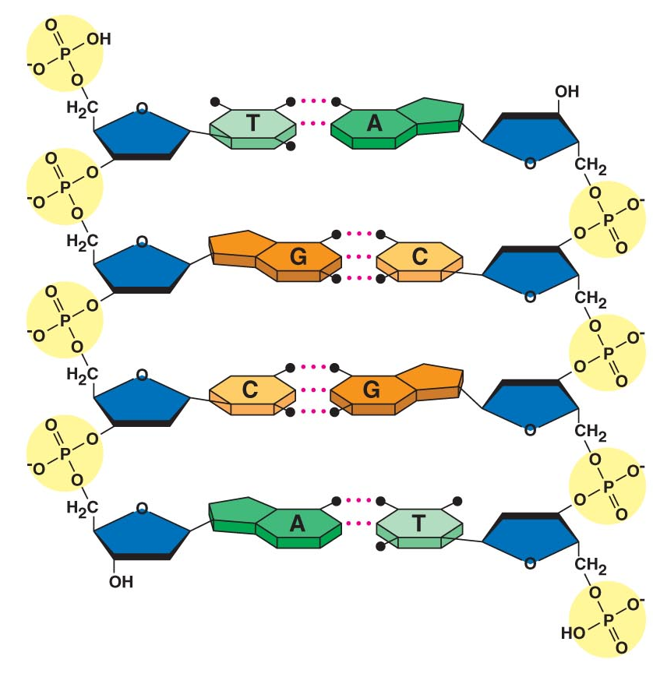
Structure of DNA … A Closer Look
Nitrogen Bases
Sugar / Phosphate
Backbone
Hydrogen Bonds

Slide 18
Structure of DNA … A Closer Look
The two sides of the ladder are made up of alternating _________________ molecules.
The rungs of the ladder are formed by the ____________.
_____ bases form each rung.
The bases are covalently bonded to a sugar-phosphate unit.
The paired bases meet across the helix and are joined together by ________ bonds.
sugar and phosphate
nitrogen bases
Two
hydrogen
_______ always pairs with thymine.
____ hydrogen bonds form between them.
_______ always pairs with cytosine.
_______ hydrogen bonds form between them.
Adenine
Two
Guanine
Three

Slide 19
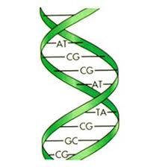
DNA as a Carrier of Information
A necessary property of genetic material is that it be able to:
carry information.
The DNA molecule is able to do this.
Sequence
of
bases
The information is carried in the ________________ and any sequence of bases is possible.
sequence of bases
Since the number of paired bases ranges from about 5,000 for the simplest virus to 6 billion in human chromosomes, the variations are infinite.
If the DNA from a single human cell were stretched out, it would reach about 6 feet. It would carry information equivalent to 1,200 books as thick as your textbook! And yet all of this information can be copied in just a few hours with very few errors.

Slide 20
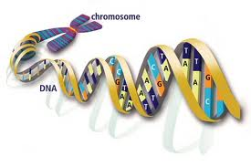

How can all of this DNA fit inside a cell?
The structure of the chromosome allows the DNA to be packed very tightly inside the cell.
A chromosome is composed of:
DNA and proteins.
The DNA is wrapped tightly around proteins called _______.
histones
Together, the DNA and histone molecules form a beadlike structure called a ___________.
nucleosome

Slide 21
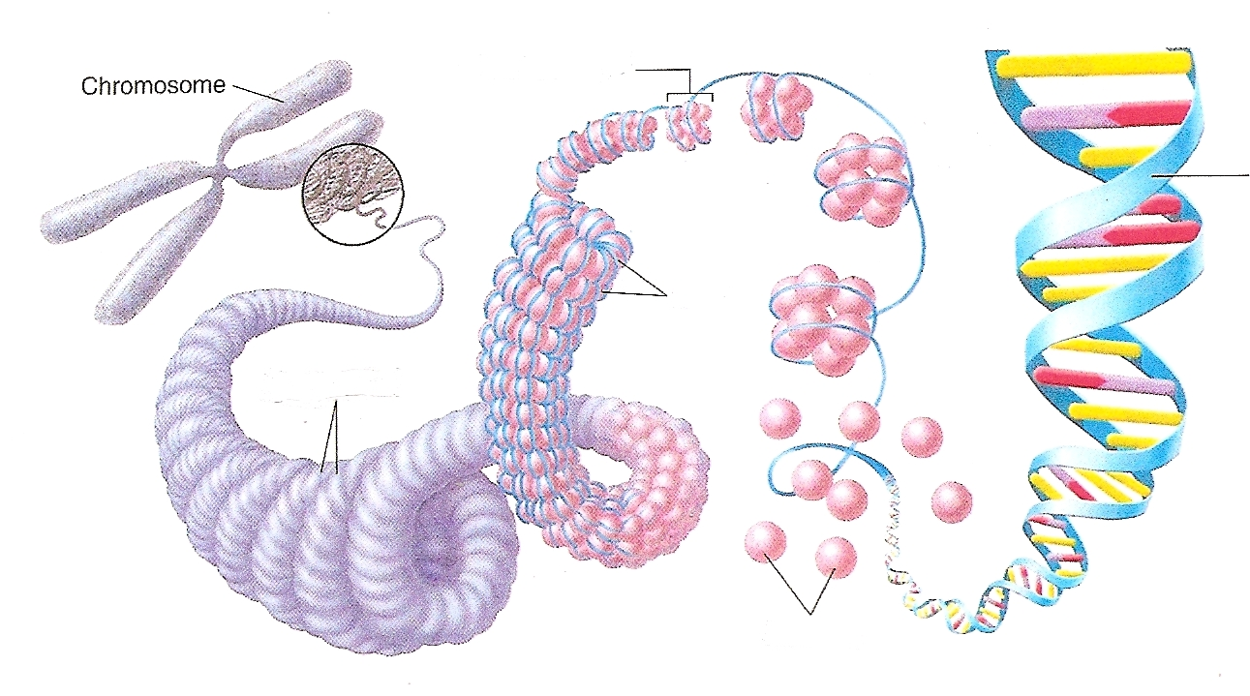
nucleosomes
DNA double helix
coils
supercoils
Nucleosomes pack with one another to form a thick fiber, which is shortened by a system of loops and coils.
histones
Nucleosomes seem to be able to fold enormous lengths of DNA into the tiny space available in the cell nucleus.

Slide 22
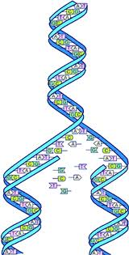
Replication of DNA – An Overview
The structure of DNA allows it to be easily copied or _________.
Each strand of the double helix has all the information needed to construct the other half by the mechanism of base pairing.
Because each strand can be used to make the other strand, the strands are said to be _____________.
replicated
complimentary
The strands will be separated and the rules of base pairing will allow new strands to be constructed.
Replication:
The process in which a DNA molecule builds an exact duplicate of itself.

Slide 23
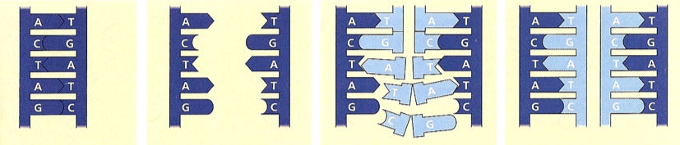
Drawing of Replication
1 2 3 4
1. The parent molecule has ________________ strands of DNA. Each base is paired to its specific partner by ________ bonding. Adenine always pairs with ________; cytosine always pairs with ________.
two complementary
hydrogen
thymine
guanine
separation
2. The first step is the __________ of the two DNA strands. The _______________ are broken between the bases. Each parental strand now serves as a template.
hydrogen bonds

Slide 24
Drawing of Replication
1 2 3 4
3. New nucleotides are inserted along both sides (both templates). As the molecule “unzips”, each nitrogen base pairs with its compliment to form a new strand just like the old one. One at a time, nucleotides line up along the template strand according to the base-pairing rules.
4. The nucleotides are connected to form the sugar phosphate backbones of the new strands. Hydrogen bonds are formed to link the two complimentary bases together. Covalent bonds are formed between the sugars and the phosphates to join the nucleotides together. Where there was one double-stranded DNA molecule at the beginning of the process, there are now two. Each is an exact replica of the parent molecule.

Slide 25
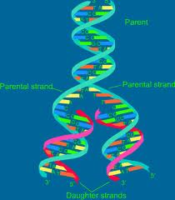
The Mechanisms of Replication – A Closer View
This replication of an enormous amount of genetic information is achieved with very few errors - only one error per 10 billion nucleotides. The replication is a speedy and accurate process.
More than a dozen enzymes and proteins participate in DNA replication.

Slide 26
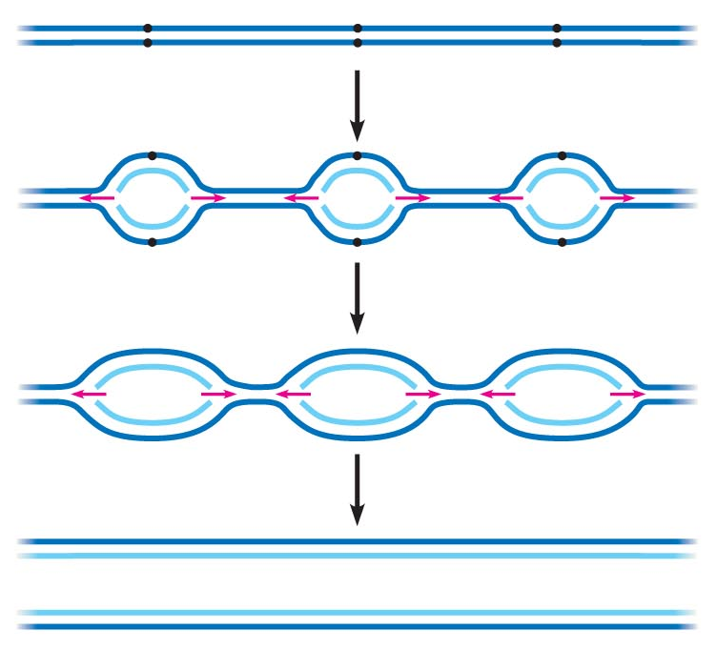
Origins of Replication and Replication Forks
origins of replication
Replication begins at special sites called "origins of replication".
DNA
Replication bubble
DNA
The end result is two identical strands of DNA
DNA
Origins of Replication are short stretches of DNA that have a specific sequence of nucleotides.
Proteins that initiate DNA replication recognize this sequence and attach to the DNA at these sites, separating the two strands and opening up a replication "bubble".
Replication then proceeds in both directions, until the entire molecule is copied.
A eukaryotic cell may have hundreds of replication origins, speeding up the copying of the very long DNA molecules.
Replication fork:
A "Y" shaped region at the end of each replication bubble where the new strands of DNA are elongating.

Slide 27
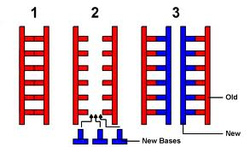
Replicating the DNA
Replication:
The process by which a cell copies
or duplicates its DNA.
During DNA replication…
….the DNA molecule separates into two strands.
Complementary strands are produced according to the _______________.
base pairing rules
Each strand of the double helix of DNA serves as a template for the new strand.

Slide 28
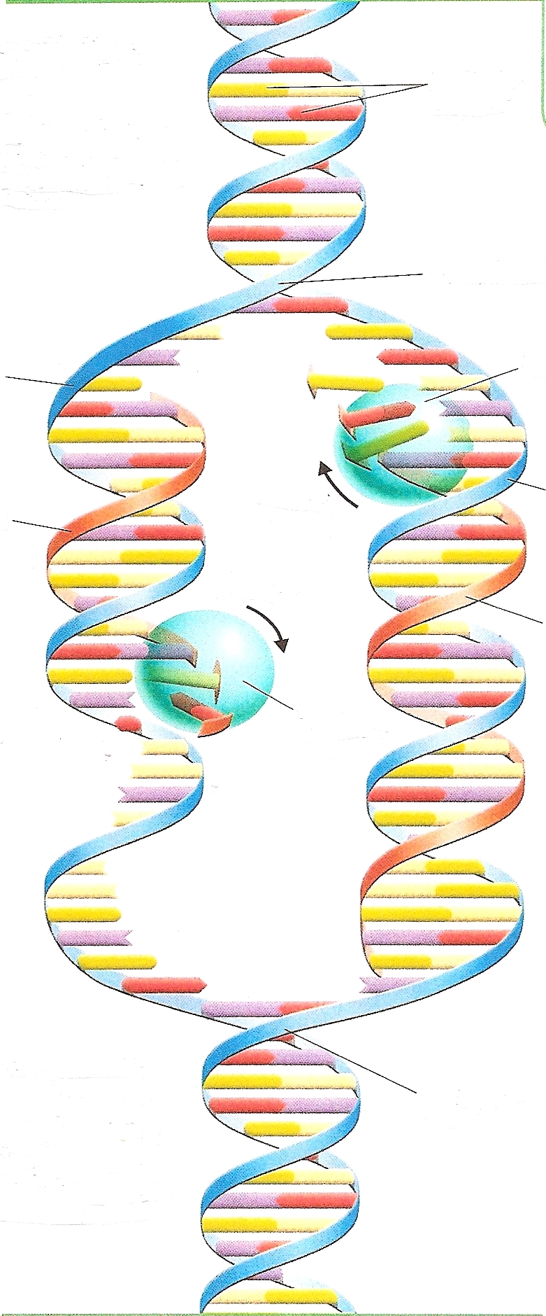
The two strands have separated and two replication forks form.
New bases are added following the base pairing rules.
For example: If there is adenine on the template strand, then a nucleotide with thymine is added to the newly forming strand.
New nucleotides are added in this way until the entire molecule has been copied.
Question: If the template strand has the bases ACTGCA, what new complementary strand would be produced?
Answer: TGACGT
The end result is two DNA molecules identical to each other.
Each DNA molecule has one original strand and one new strand.
Nitrogen bases
Replication fork
DNA polymerase
Original strand
New strand
DNA
polymerase
Replication fork

Slide 29
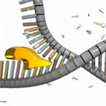
There are many enzymes involved in the replication of DNA.
This group of enzymes:
breaks the hydrogen bonds between complementary base pairs.
Helicases
This “unzips” the DNA molecule, forming two replication forks.
When the hydrogen bonds are broken, the two strands of the DNA molecule unwind allowing each strand to serve as a template for the attachment of the new nucleotides.
Helicases are enzymes that untwist the double helix at the replication forks, separating the two parental strands and making them available as template strands.

Slide 30
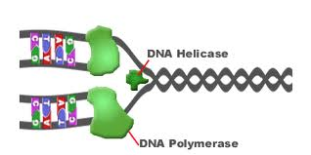
DNA
Polymerase
DNA polymerase is the principle enzyme involved in DNA replication.
These enzymes add the new nucleotides to the existing chain.
The rate of elongation is about 50 nucleotides per second in human cells.
DNA polymerase also proofreads each new DNA strand to insure that an exact copy has been made.
Eleven different DNA polymerases have been discovered so far.

Slide 31
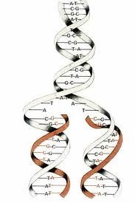
Proofreading the DNA
As DNA polymerase adds nucleotides to the growing DNA strand, there is an error rate of about 1 in 100,000 base pairs.
DNA polymerases proofread as nucleotides are added.
If a mistake is found, the DNA polymerase removes the nucleotide and resumes synthesis.
A good analogy is hitting the delete key when you make a typing error.
Errors in the completed DNA strand amount to only 1 in 10 billion nucleotides since many of the errors are corrected before replication is completed.

Slide 32
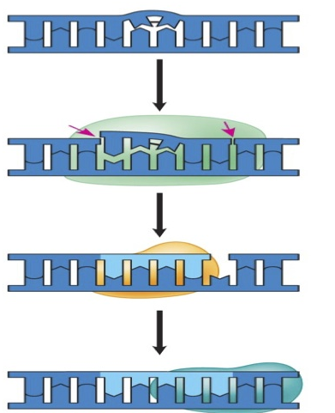
Accidental changes can occur in existing DNA after replication. The DNA can become ________ from exposure to chemicals, radioactivity, X-rays, ultraviolet light, and molecules in cigarette smoke.
Each cell continuously___________________________________. About 130 DNA repair enzymes have been identified so far.
damaged
monitors and repairs its genetic material
Repairing the damage:
Damaged DNA
The damaged segment of DNA is cut out by enzymes called nucleases.
The resulting gap is filled in with new nucleotides by DNA polymerases.
Other enzymes (ligases) seal the free ends of the new DNA to the old DNA, making the strand complete.
Nucleases cut out the damaged section.
DNA polymerases replace the gaps with new nucleotides.
Ligases seal the new section in place.

Slide 33



We now know that the DNA molecule carries the instructions for the structure and functioning of the cell, and passes these instructions on to new cells.
How are the instructions carried out?
How do genes work?

Slide 34
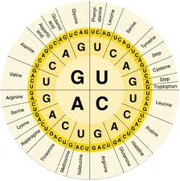
The Genetic Code
The DNA molecule, with its four nitrogenous bases, is the ____ for all _________ that are made in a cell.
code
proteins
Genes are made of _____. A gene is the _________________that controls the production of specific _________, such as enzymes, structural proteins, oxygen-carrying proteins, etc.
DNA
coded DNA instructions
proteins
The DNA inherited by an organism dictates the synthesis of certain proteins. Proteins are the link between
genotype and phenotype.
The proteins that are made will determine what traits show up in the offspring.
Gene expression:
The process by which DNA directs the synthesis of proteins.
The expression of genes includes two stages:
transcription and translation

Slide 35
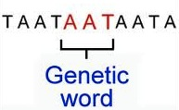
The Code Is A Triplet
Proteins are made of building blocks called:
amino acids.
2. There are ___ different amino acids and ____ different nucleotides (since there are four different nitrogenous bases).
3. It was discovered that ______________ in sequence must specify each __________. This would provide for ___ possible combinations of amino acids.
4. Each ______ of nucleotides is called a _______.
20
four
three nucleotides
amino acid
64
triplet
codon

Slide 36
The Code Is A Triplet
Each codon calls for a specific __________. When many __________ are linked together a ______ is made.
A few codons do not call for any amino acids. One codon acts as a ______ codon to tell where the sequence of amino acids is to begin. Three other codons are _____________ and act as signals for the end of a protein chain.
A gene on a chromosome is many, many codons long. Each gene is the code for a particular ______.
Genes provide the __________ for making specific proteins, but a gene does not build a protein directly. The bridge between DNA and protein synthesis is:
amino acid
amino acids
protein
“start”
“stop” codons
protein
instructions
RNA

Slide 37
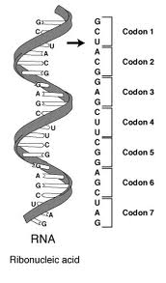
RNA – Ribonucleic Acid
Differences Between DNA and RNA:
RNA is a single strand; DNA is a double strand.
The sugar in RNA is ribose; the sugar in DNA is deoxyribose.
RNA has uracil that pairs with adenine; DNA has thymine that pairs with adenine.

Slide 38
Functions of RNA
ribosomes
Proteins are made in the _______ in the cytoplasm.
DNA determines which proteins need to be made.
A gene on the DNA molecule is ______. This copy is called ____. The copy of the instructions is then sent out to the ___________________.
RNA carries the messages from the DNA (in the nucleus) to the ribosomes (in the cytoplasm). RNA tells the ribosomes which proteins to make and how to make them.
copied
RNA
ribosomes in the cytoplasm

Slide 39
Messenger RNA - mRNA
Messenger RNA travels from the nucleus to the cytoplasm (ribosomes) with the instructions for making proteins.
Messenger RNA is the “messenger” between the DNA in the nucleus and the ribosomes in the cytoplasm.
The instructions are carried in the form of codons. The first codon is called the start codon. This is the point at which mRNA will attach to the ribosome. This tells the ribosome where the instructions start.
The rest of the molecule is a sequence of nucleotides that dictates the sequence of amino acids for the particular protein that is being made.
The last codon is called the “stop” codon. This tells the ribosome to stop the production of the protein.

Slide 40
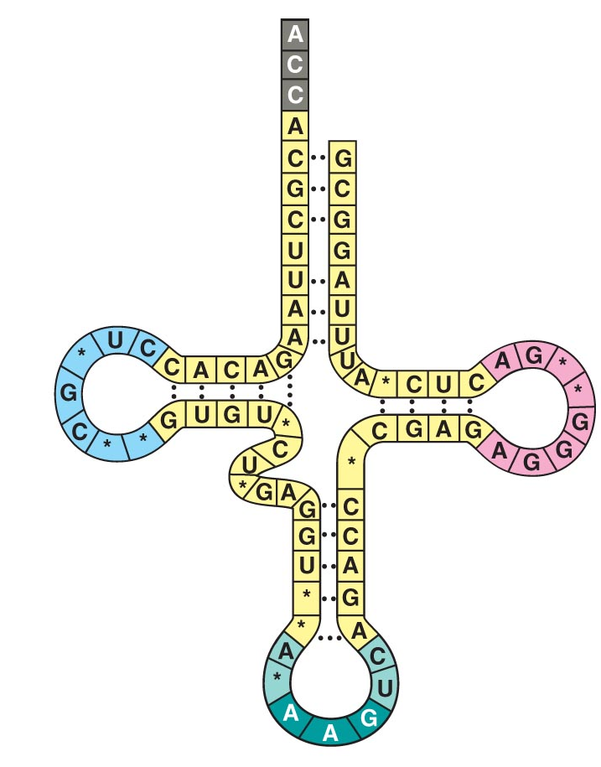
Transfer RNA -- tRNA
Transfer RNA reads the ________ carried by _______ and gathers the right ___________ for making that _______.
Amino acid will be attached here.
message
Transfer RNA transfers amino acids from the cytoplasmic pool of amino acids to a _________.
mRNA
amino acids
protein
ribosome
A cell keeps its cytoplasm stocked with all 20 amino acids.
One end of the tRNA attaches to ____________ and carries it to the ribosome.
one amino acid

Slide 41
Ribosomal RNA - rRNA
Ribosomal RNA is found in the ribosome.
These are used to bind the mRNA and the tRNA to the ribosome. This allows all components required for the synthesis of the proteins to be held together.

Slide 42
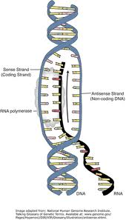
Transcription
Transcription is the process of forming a strand of RNA from a strand of DNA.
2. This process occurs in the nucleus.
The cell must make RNA to send to the cytoplasm to tell the ribosomes how and which proteins to make.
The RNA molecule is a faithful copy of a gene’s protein building instructions. This type of RNA is called messenger RNA (mRNA).
An enzyme called RNA polymerase catalyzes this reaction.
The purpose of transcription is to copy one gene from the DNA molecule.
Where does one gene end and the next gene begin?
a) Promoter: A DNA sequence where RNA polymerase attaches and initiates transcription.
b) Terminator: The DNA sequence that signals the end of transcription.

Slide 43
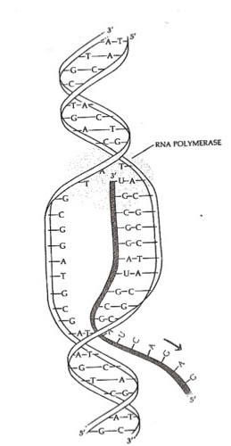
Steps of Transcription
______________ binds to a site on the DNA molecule called the ________.
RNA polymerase
promoter
Separates the DNA strands.
RNA polymerase:
One strand of DNA is used as a template.
New nucleotides are inserted according to the base pairing rules. When transcribing RNA, Adenine pairs with ______; cytosine pairs with ________.
This continues until the __________ is reached.
As the RNA polymerase moves along the DNA molecule, hydrogen bonds between the two strands of DNA are reformed.
A singled stranded RNA molecule has been transcribed.
uracil
guanine
terminator
Single stranded RNA

Slide 44
Steps of Transcription
Remember: The purpose of transcription is ____ to copy the __________ of the DNA molecule, but to copy only small portions - a gene’s worth - to be sent to the ribosome as the:
instructions for protein synthesis.
NOT
entire length

Slide 45
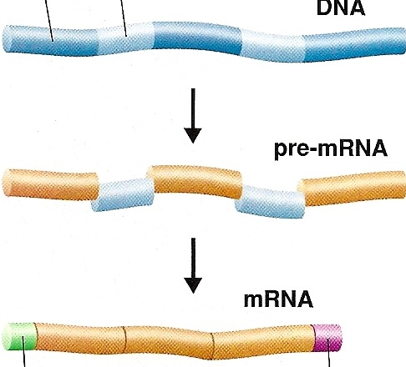
RNA Processing and Editing
The RNA is not yet ready to be sent out to the cytoplasm. It must be ________ before it is ready to serve its purpose.
exon
intron
modified
The mRNA is a copy of a small section of DNA.
This RNA contains sections called _______ and other sections called ______.
introns
exons
Introns are sequences of nitrogen bases that…
are not involved in the making of the protein.
These need to be ________ of the RNA before the RNA goes to the ribosomes.
cut out

Slide 46
RNA Processing and Editing
intron
Exons are the sequences of nitrogen bases that are involved in the making of the protein.
exon
When mRNA is formed, both the introns and exons are copied from the DNA.
exon
exon
intron
intron
However, the introns are _______ of the RNA while the RNA is still inside the nucleus.
cut out
exon
exon
spliced back together
The remaining exons are __________________ to form the final RNA.

Slide 47
RNA Processing and Editing
Finally, ___________ are added to form the final RNA molecule.
intron
a cap and tail
exon
The cap and tail help to identify the “front end” of the RNA from the “back end”.
exon
exon
cap
tail
The cap and tail help the ribosome to identify the _____ of the instructions and the ___ of the instructions.
start
end

Slide 48

If introns are not needed and will be cut out of the RNA, why are they there in the first place?
When introns are present in genes, it allows a ___________ to code for more than one type of _______, depending on which segments are treated as introns and which are treated as exons.
single gene
protein
When particular segments are cut out, one type of protein might result. If different segments are cut out, a different type of protein would result.

Slide 49
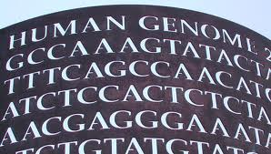
The Genetic Code
Proteins are made by joining together long:
chains of amino acids.
The order in which the amino acids are joined:
determines the type of protein that is made.
The genetic code is read __________________ at a time. Each group of three nitrogen bases is called a _____.
three nitrogen bases
codon
The “language” of mRNA instructions is called the genetic code.
A codon is a group of three nitrogen bases that specifies _____________.
one amino acid

Slide 50
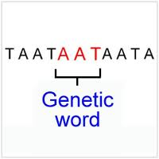
Consider the following RNA sequence, for example:
UCGCACGGU
The sequence would be read three bases at a time:
UCG - CAC - GGU
These three codons represent three different ___________. From your chart of amino acids, determine the three amino acids coded for by these codons:
amino acids
serine - histidine - glycine

Slide 51
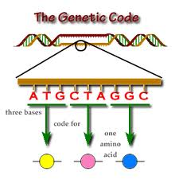
Since there are ____ different bases read in groups of _____, there are __ possible codons.
four
three
64
There is one codon, ____, which specifies the amino acid, ________.
This codon serves as the “____” codon for protein synthesis.
This codon is found at the beginning of every set of mRNA instructions.
This codon “tells” the ribosome where the instructions will start.
AUG
methionine
start
There are three “_____” codons. These do not code for any amino acid. Stop codons act like the period at the end of the sentence. Stop codons signify the end of the protein.
stop

Slide 52
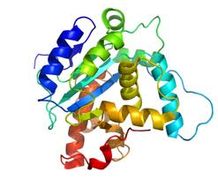
Protein Synthesis (Translation)
The synthesis of proteins is called ___________.
The cell must translate the base sequence of an ______ molecule into the __________ sequence of a protein.
translation
mRNA
amino acid
The site of translation, or _________________, occurs in the _________. The ribosome facilitates the orderly linking of amino acids into proteins.
During translation, the cell uses information from mRNA to produce proteins.
protein synthesis
ribosome

Slide 53
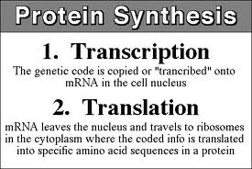
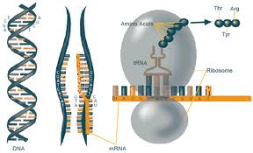
Steps in protein synthesis:
In the nucleus, DNA transcribes RNA.
The RNA is sent to the cytoplasm in the form of mRNA.
The mRNA attaches to a ribosome.
As each codon of the mRNA molecule moves through the ribosome, the proper _________ is brought into the ribosome by _____. The amino acids are lined up in the right order on the ribosome.
The ribosome hitches the amino acids together with peptide bonds and proteins are made.
amino acid
Transcription
Translation
tRNA

Slide 54
Transfer RNA
The function of tRNA is to ____________________ from the cytoplasm’s amino acid pool to a ribosome. A cell keeps its cytoplasm stocked with all 20 amino acids. The ribosome adds each amino acid brought to it by tRNA to the growing end of a polypeptide chain.
transfer amino acids
Amino acid will be attached here
Transfer RNA molecules are not all the same. Each type of tRNA molecule links a particular ___________ with a particular _________.
mRNA codon
These three bases are the “anticodon”.
amino acid
As a tRNA arrives at a ribosome, it carries a specific amino acid at one end. At the other end is a ______________ called an _________.
nucleotide triplet
anticodon

Slide 55
For example: If an mRNA codon is ____, this would translate as the
amino acid ___________.
The tRNA that delivers the amino acid phenylalanine has as its anticodon ____.
It carries ____________ at its other end.
phenylalanine
UUC
phenylalanine
AAG
phenylalanine
Each tRNA is used repeatedly to locate a particular __________ and _______ it at the ribosome. It then leaves the ribosome to go and find another amino acid.
anticodon
amino acid
deposit

Slide 56
The codons must be read correctly and in the correct order.
Consider the statement:
The red dog ate the cat
If the reading of the code starts at the wrong place:
(Omit the first “T”…….)
her edd oga tet hec at
The result will be gibberish. A protein will be made putting the _______________ in order. It is unlikely that this protein will be able to function.
wrong amino acids

Slide 57
Example: Putting It All together!
If the sequence on the DNA molecule calls for a protein with the following DNA codons:
(1) What would be the sequence of the mRNA?
(2) What would be the sequence on the tRNA?
(3) What would be the amino acid sequence of the protein being made?
DNA → TAC TTA CAA ACC ATA ATT
mRNA →
tRNA →
AUG
AAU
GUU
UGG
UAU
UAA
CODONS
UAC
UUA
CAA
ACC
AUA
AUU
ANTICODONS
Amino →
Acid
Sequence
Methionine
Asparagine
Valine
Tryptophan
Tyrosine
STOP

Slide 58
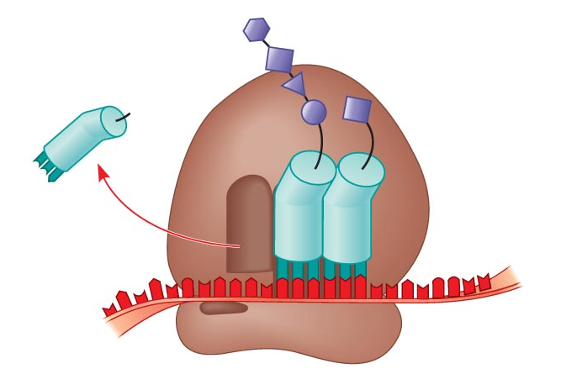
A More Detailed Look at Translation
A ribosome is made up of ___________.
They are called the ____________ and the _____________.
The subunits are constructed of ________ and RNA molecules named:
ribosomal RNA (rRNA).
two subunits
large subunit
small subunit
proteins
These subunits are made in the _________ and are exported to the cytoplasm.
nucleolus

Slide 59
This tRNA is holding the growing protein and will shift it over to the incoming amino acid.
This tRNA is leaving the ribosome and will go get another amino acid to bring to the ribosome.
This tRNA is delivering the next amino acid for the protein.
large subunit
mRNA
small subunit
Large and small subunits join to form a functional ribosome only when they attach to an mRNA molecule.
Each ribosome has a binding site for mRNA and three binding sites for tRNA.

Slide 60
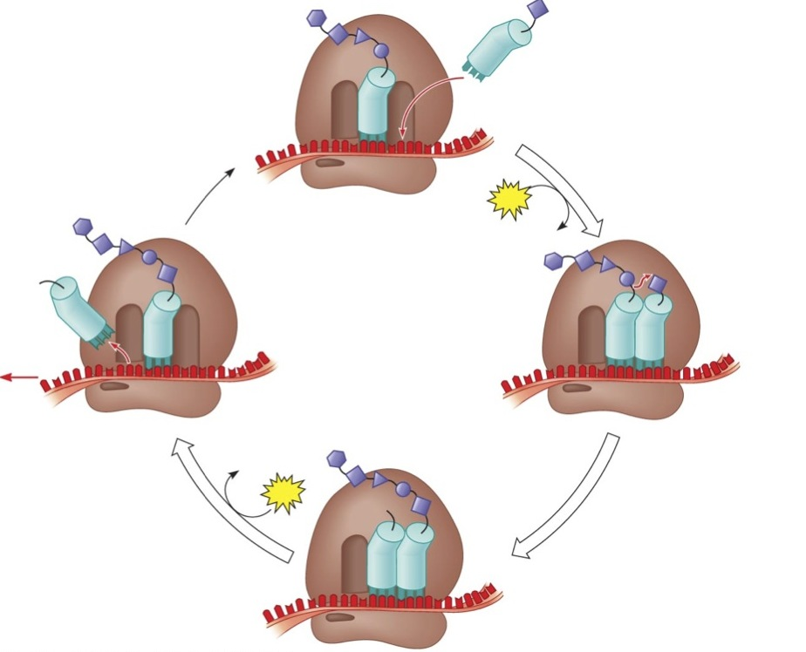
Translation – The Building of a Protein
Transfer RNA begins at AUG, the __________. Each transfer RNA has an _________ whose bases are complimentary to a codon on the ______ strand. A tRNA arrives carrying the amino acid __________.
start codon
anticodon
mRNA
methionine

Slide 61
Translation – The Building of a Protein
The first tRNA has completed its job and exits from the ribosome.
Another tRNA arrives with the next __________.
amino acid
The tRNA shifts the growing polypeptide to the newly arriving tRNA.
The tRNA molecules shift to the next site in the ribosome.
The ribosome forms a bond between the two amino acids.

Slide 62
Translation – The Building of a Protein
Amino acids are added one by one until the “____” codon is reached.
stop
The result is a complete polypeptide (protein).

Slide 63
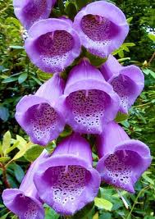


The Relationship Between Genes and Proteins
Genes are nothing more than instructions for building proteins.
What do proteins have to do with the color of a flower, a human blood type, or dimples?
The answer is….
EVERYTHING!
The traits of any organism are the result of the proteins being built within the cells.

Slide 64


Mutations
On occasion cells make mistakes in ________________. An incorrect nitrogen base may be inserted or a base may be skipped altogether.
copying their DNA
These mistakes are called _________.
mutations
Mutations may be either _____ mutations or ___________ mutations.
Mutations are changes in the genetic material of a cell.
gene
chromosome
Gene mutations produce a change within a ___________. Chromosome mutations produce changes in the ______ chromosome.
single gene
whole

Slide 65

Point
Mutations
one base pair
Point mutations are changes in just _____________ of a gene.
These are called point mutations because they occur at a single point in the DNA sequence.
There are two types of point mutations:
a) base pair substitutions
b) base pair insertions or deletions

Slide 66
Base Pair Substitutions
1. A base pair substitution is the _________________________________________.
2. It would affect just that one amino acid coded for by that codon.
If the substitution is in the 3rd position, it may not have any effect on the organism since there is some redundancy of codons.
For example: Alanine: GCU
GCC
GCA
GCG
A point mutation at the third position would have ________ whatsoever. The codon would still call for the amino acid _______. These are called ______________.
If the substitution were in the ____________ position, it would have a _______ effect. The wrong amino acid would be called for and inserted into the polypeptide chain that is being manufactured. Only that one amino acid would be affected.
A switched amino acid ______________ have any effect on the proper functioning of that protein. If the alteration of a single protein is in a crucial area, such as the active site on an enzyme, the protein will not function properly.
replacement of one nitrogen base with another
no effect
alanine
silent mutations
first or second
greater
may or may not

Slide 67
Let’s look at another example:
What amino acid would be called for by the codon AAG?
Answer: Lysine
What would happen if an “A” was substituted at the third position in this codon?
Answer: The codon AAA would still call for the amino acid lysine. There would be no effect on the protein being made.
What would happen if a “C” was substituted at the third position in this codon?
Answer: The codon AAC would call for the amino acid asparagine. The protein being made would be altered.
What would happen if there was a substitution at the 1st or 2nd position in this codon?
Answer: The wrong amino acid will be called for. The protein being made would be altered.

Slide 68
Insertions and Deletions
1. This is the:
2. These have a disastrous effect on the resulting protein.
3. For example:
AUG AAU GUU UGG UAU UAA
If the “G” is deleted in the first codon, the codons would be read as follows:
AUA AUG UUU GGU AUU AA
The codons are still read in groups of _____ nitrogen bases.
All of the nucleotides that are downstream of the deletion or addition will be improperly grouped into ______.
The addition or deletion of a base would alter the reading of the entire rest of the mRNA.
These are called __________ mutations.
Frameshift mutations can alter a protein so much that it is unable to perform its normal functions.
addition or deletion of a nitrogen base.
three
codons
frameshift

Slide 69

The Importance of Mutations
Most gene mutations are _______.
They have little or no effect.
neutral
Some mutations cause such dramatic changes that normal cell functions are disrupted and may result in a genetic disorder.
Some mutations may actually be beneficial. The mutation may cause a change in the organism that makes it better suited for its environment.
Those organisms that are better suited are more likely to survive, reproduce, and pass these favorable traits on to their offspring. This is the mechanism of Natural Selection.

Slide 70


Created by Amy Brown – Science Stuff
Copyright © February 2012 Amy Brown (aka Science Stuff)
All rights reserved by author.
This document is for your classroom use only.
This document may not be electronically distributed or posted to a web site.

