Slide 1
AP Environmental Science
Biogeochemical Cycles

Slide 2
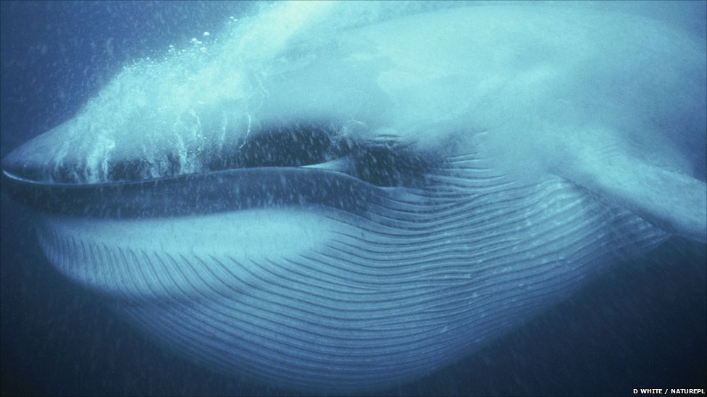
Biogeochemical Cycle: The comprehensive set of cyclical pathways by which a given nutrient moves through the environment.

Slide 3
Nutrients circulate through ecosystems
Matter is continually circulated in ecosystems
Nutrient (biogeochemical) cycles = the movement of nutrients through ecosystems
  Atmosphere, hydrosphere, lithosphere, and biosphere
Pools (reservoirs) = where nutrients reside for varying amounts of time (the residence time)
Flux = the rate at which materials move between pools
  Can change over time
  Is influenced by human activities
Notes:
3
3

Slide 4
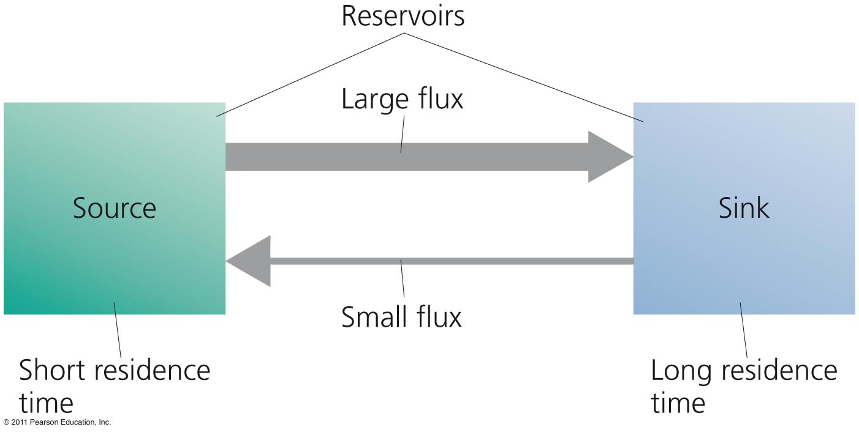
Main components of a biogeochemical cycle
Source = a pool that releases more nutrients than it accepts
Sinks = a pool that accepts more nutrients than it releases

Slide 5
The Hydrologic Cycle
Water is essential for biochemical reactions
  It is involved in every environmental system
Hydrologic cycle summarizes how liquid, gaseous and solid water flows through the environment
  Oceans are the main reservoir
Evaporation = water moves from aquatic and land systems into the atmosphere
Transpiration = release of water vapor by plants
Precipitation, runoff, and surface water = water returns to Earth as rain or snow and flows into streams, oceans, etc.

Slide 6
Groundwater
Aquifers = underground reservoirs of sponge-like regions of rock and soil that hold…
  Groundwater = water found underground beneath layers of soil
Water table = the upper limit of groundwater in an aquifer
  Water may be ancient (thousands of years old)
Groundwater becomes exposed to the air where the water table reaches the surface
  Exposed water runs off to the ocean or evaporates

Slide 7
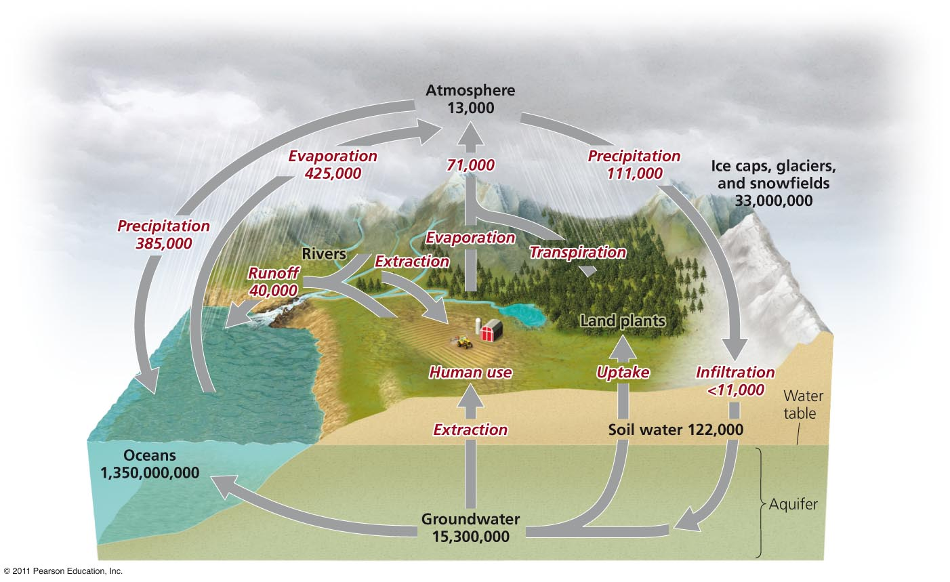
The hydrologic cycle

Slide 8
The Carbon Cycle
Carbon is found in carbohydrates, fats, proteins, bones, cartilage and shells
Photosynthesis by plants, algae and cyanobacteria
  Removes carbon dioxide from air and water
  Produces oxygen and carbohydrates
  Plants are carbon reservoirs
Respiration returns carbon to the air and oceans
  Consumers and decomposers
Notes:
8
8

Slide 9
Sediment Storage of Carbon
Decomposition returns carbon to sediments
  The largest reservoir of carbon
  May be trapped for hundreds of millions of years
Aquatic organisms die and settle in the sediment
  Older layers are buried deeply and undergo high pressure
  Ultimately, it may be converted into fossil fuels
Oceans are the second largest reservoir of carbon

Slide 10
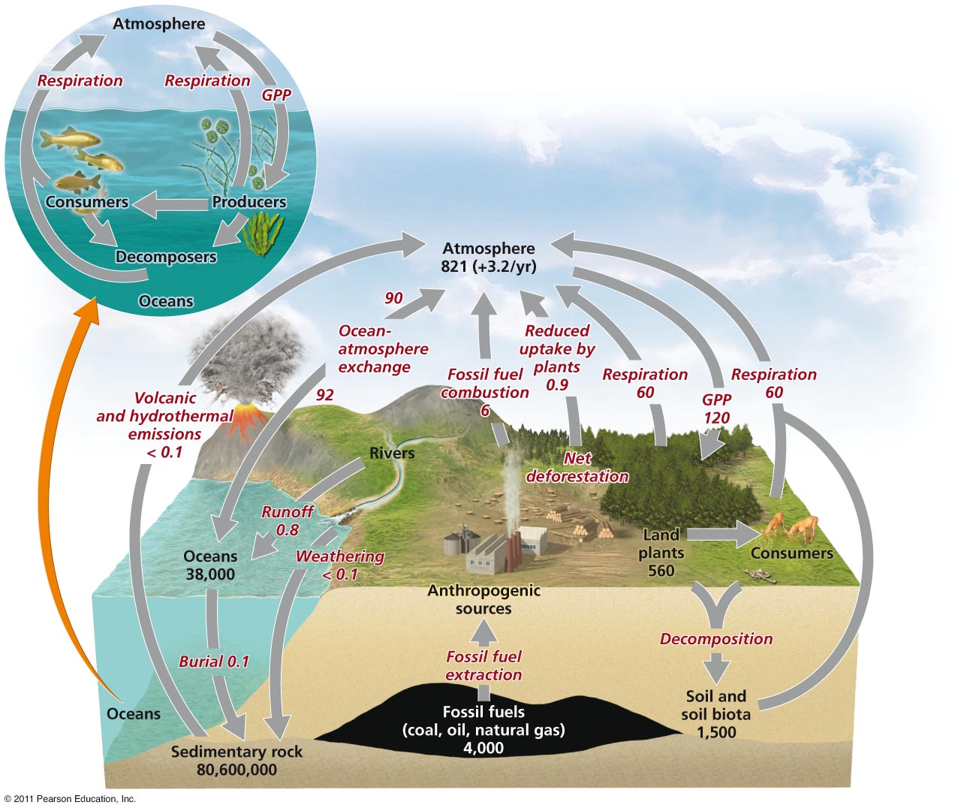
The carbon cycle

Slide 11
The Nitrogen Cycle
Nitrogen comprises 78% of our atmosphere
  It is found in proteins, DNA and RNA
  Nitrogen gas cannot be used by organisms
Nitrogen fixation = lightning or nitrogen-fixing bacteria combine (fix) nitrogen with hydrogen
  To form ammonium which can be used
  by plants

Slide 12
Nitrification and denitrification
Nitrification = bacteria convert ammonium ions first into nitrite ions then into nitrate ions
  Plants can take up these ions
Consumers obtain nitrogen by eating plants or other animals
Decomposers get it from dead and decaying plants or other animals
  Releasing ammonium ions to nitrifying bacteria
Denitrifying bacteria = convert nitrates in soil or water to gaseous nitrogen
  Releasing it back into the atmosphere

Slide 13
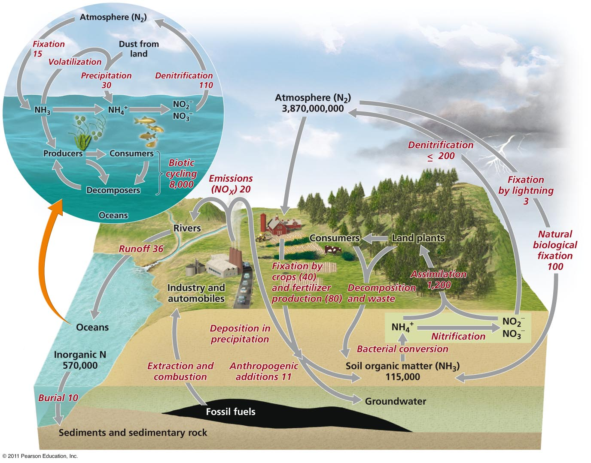
The nitrogen cycle

Slide 14
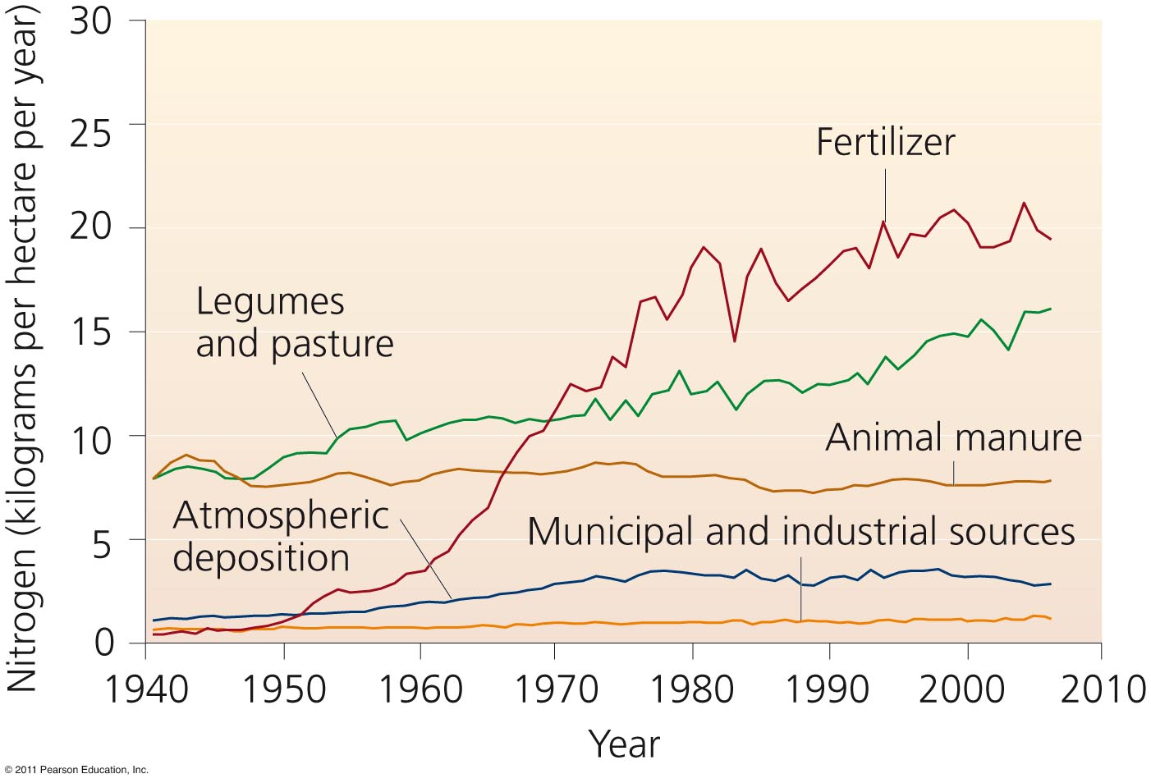
Humans put nitrogen into the environment
Fully half of nitrogen entering the environment is of human origin

Slide 15
The Phosphorus Cycle
Phosphorus (P) is a key component of cell membranes, DNA, RNA, ATP and ADP
Most phosphorus is within rocks and is released by weathering
****There is no significant atmospheric component
With naturally low environmental concentrations phosphorus is a limiting factor for plant growth

Slide 16
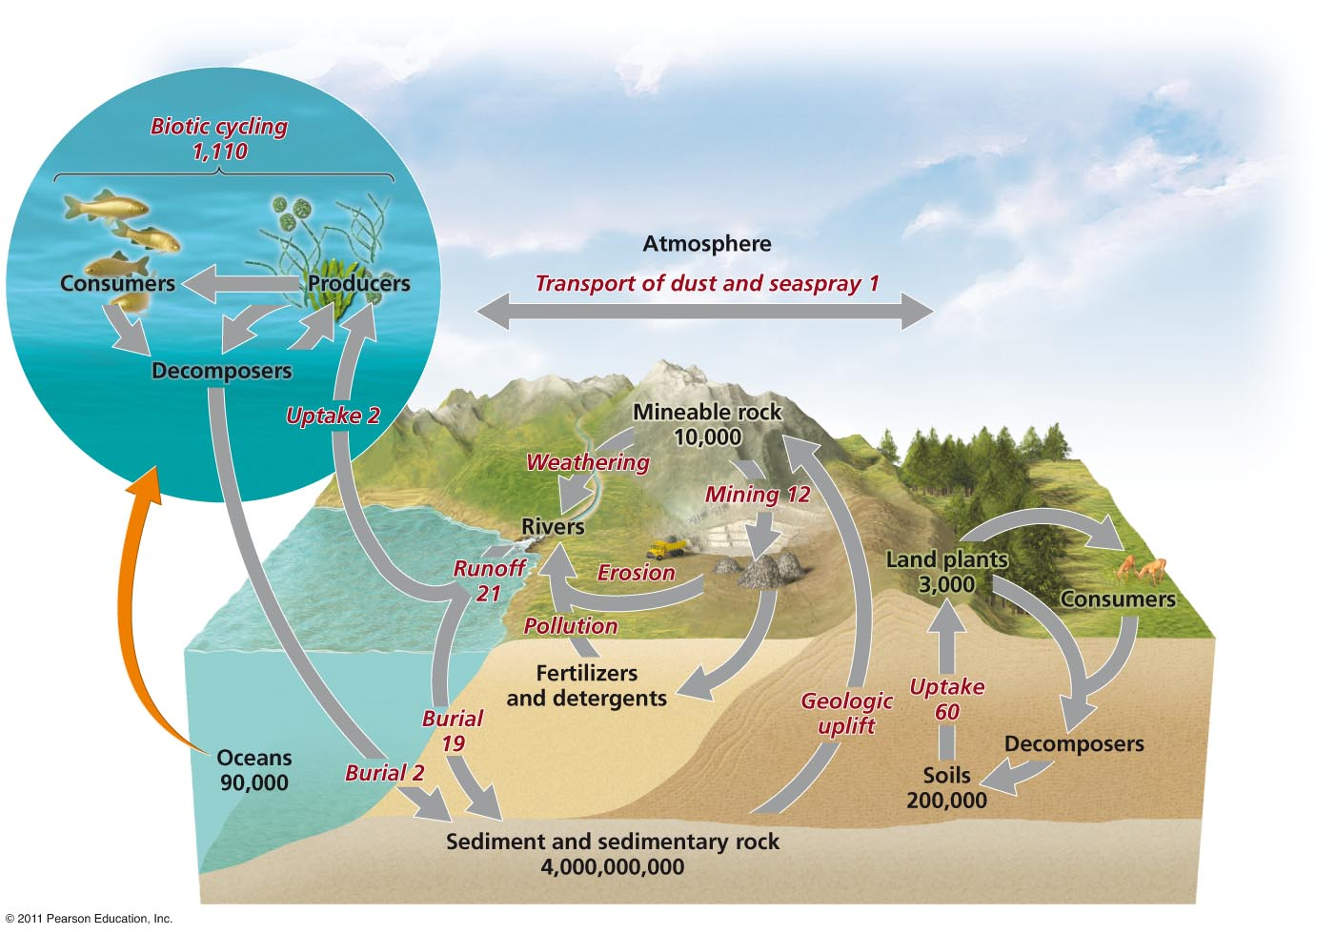
The phosphorus cycle

Slide 17
APES Water & Biogeochemical Cycles Project
For each of the five cycles, draw a detailed diagram, including labels and captions. After this project, you should be able to thoroughly explain the processes involved, so if there is any part that is not clear (to you), dig deeper and add more detail to your diagram. This part must be hand-drawn & labeled.
In addition, describe the ways in which humans have an effect on each cycle:
Water Cycle – at least 3 ways Carbon Cycle – at least 2 ways Nitrogen Cycle – at least 5 ways Phosphorus Cycle – at least 3 ways Sulfur Cycle – at least 3 ways | This part does not need to be hand-written, but don’t just cut and paste. You need to understand and be able to explain the impacts that humans have had and continue to have on each of these global cycles.

